Slide 1


Adarsh Pandey
Construction Sites Analysis
2021-2022
Building the Future with Excellence

Slide 2
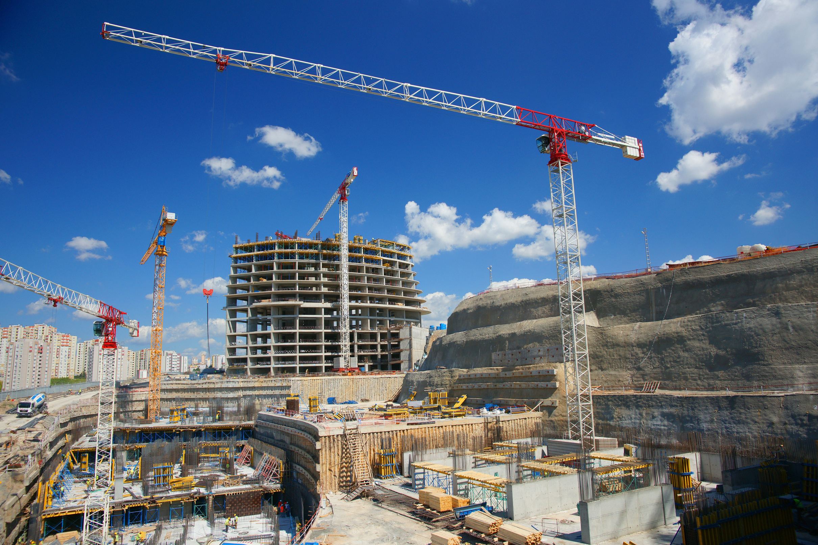

Adarsh Pandey
CONSTRUCTION SITES DATABASE
This database was designed to manage various aspects of construction projects, including locations, contractors, project progress, budget management,
and project milestones.

Slide 3
Adarsh Pandey
DATA BASE OBJECTIVES
START FROM $3200
•Track multiple construction projects in different locations.
•Manage contractor and workforce information associated with each project.
•Monitor project phases and milestones to assess progress.
•Oversee actual costs for financial control.

Slide 4
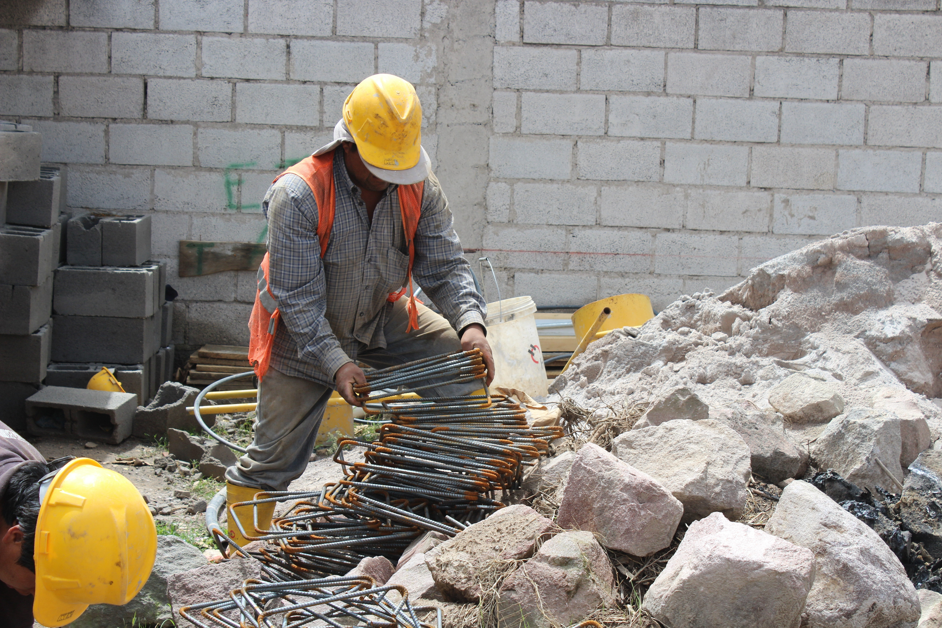

Adarsh Pandey
TABLE SUMMARIES
1. Locations Table
•Stores information about project locations, including city, state, country, and zip code.
2. Contractors Table
•Holds contractor details such as name, contact information, and company name.
3. Projects Table
•Central table for project details: Project name, start and end dates, status, location, budget, and associated contractor.

Slide 5
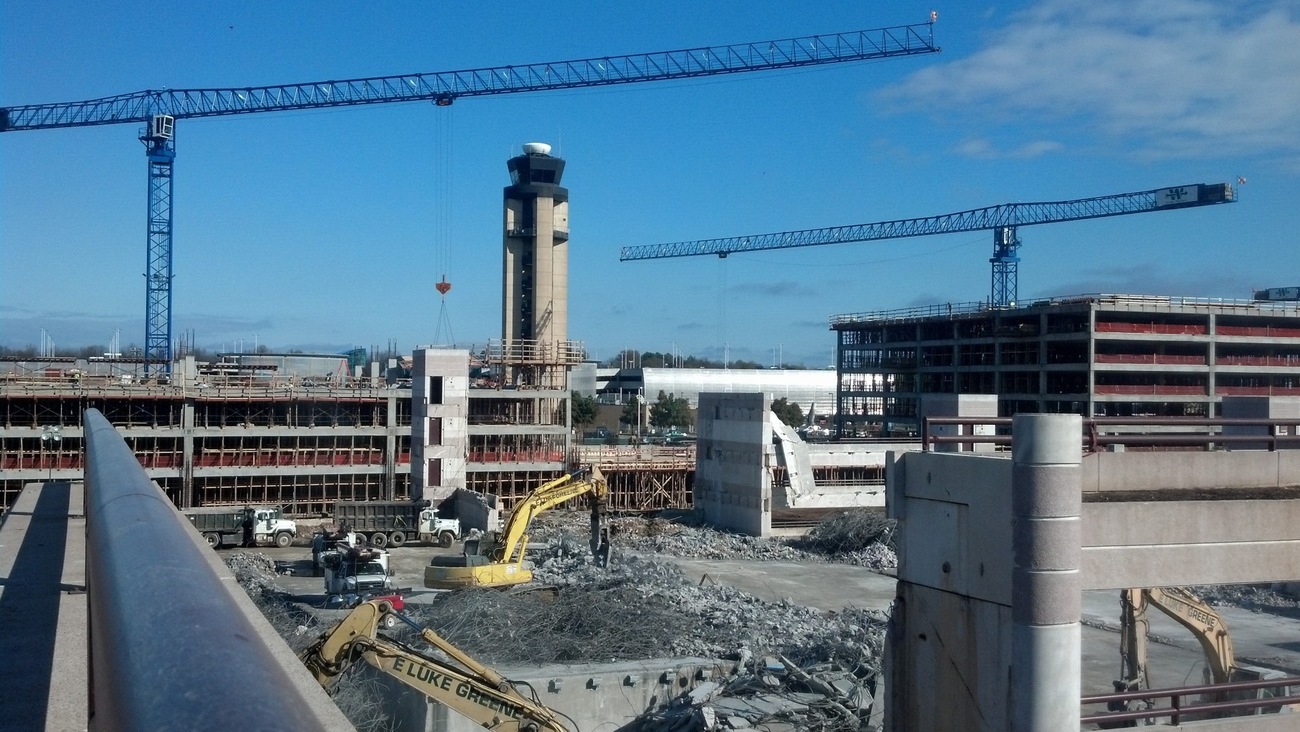
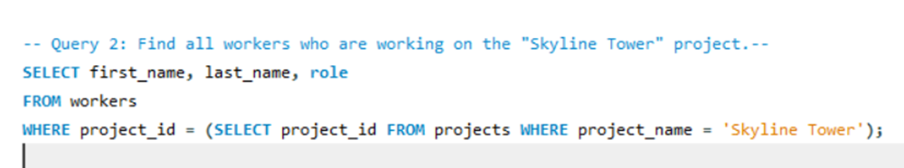
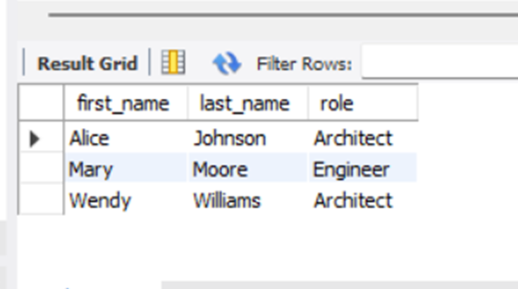
Adarsh Pandey
QUERY 1 – WORKERS ON "SKYLINE TOWER" PROJECT
•A subquery fetches the Project_id for "Skyline Tower."
•The main query then retrieves the first name, last name, and role of each worker associated with this Project_id.

Slide 6
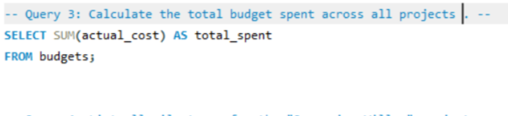
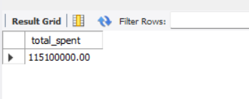
Adarsh Pandey
QUERY 2 – TOTAL BUDGET SPENT ACROSS ALL PROJECTS
•A subquery filters for Project_ids of projects that began in 2022.
•The main query

Slide 7

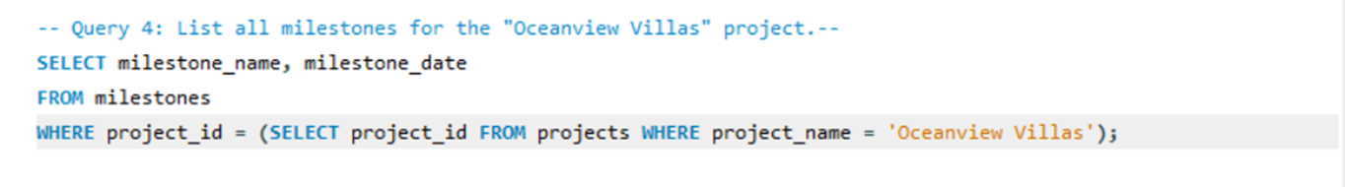
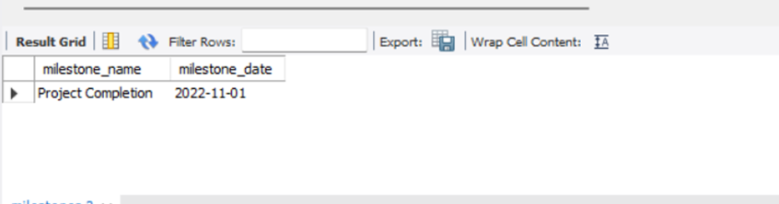
Adarsh Pandey
QUERY 3 – MILESTONES FOR "OCEANVIEW VILLAS" PROJECT
•A subquery identifies the Project_id of "Oceanview Villas."
•The main query selects all milestones related to this project_id, including the milestone name and date.

Slide 8
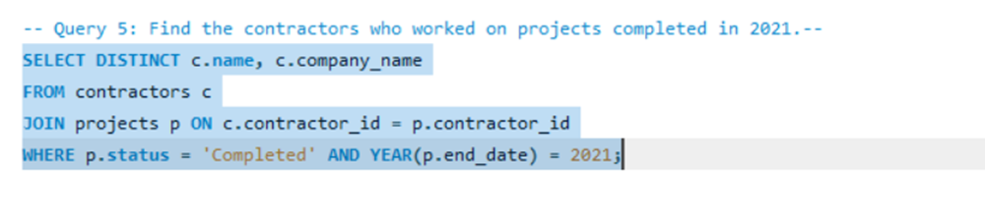
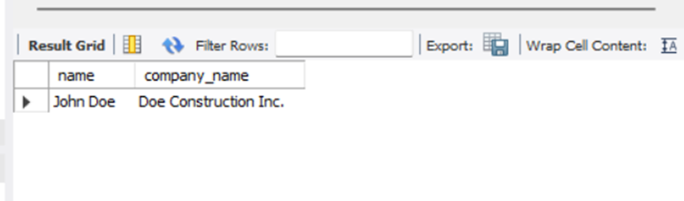
Adarsh Pandey
QUERY 4 – CONTRACTORS FOR PROJECTS COMPLETED IN 2021
•Filters projects that were marked as "Completed" in 2021.
•Uses DISTINCT to avoid duplicate contractor entries.

Slide 9

Adarsh Pandey
CONCLUSION
•The SQL queries demonstrated are crucial for efficient management and tracking of construction projects.
•By querying specific details—like active projects, personnel assignments, total spending, project milestones, and contractor involvement.
•Key Takeaways:
•Efficiency: Quickly retrieve essential project information to support decision-making.
•Cost Management: Track budgets and actual spending to ensure financial control.

Slide 10
Adarsh Pandey
MESSAGE
"In construction, every detail matters. A strong database and well-crafted queries enable us to bring precision, clarity, and control to each stage of project development. Let’s continue leveraging data to build smarter, safer, and more sustainable structures for tomorrow."

Slide 11

Adarsh Pandey
THANK YOU
FOR ATTENTION
Building the Future with Excellence

